Slide 1
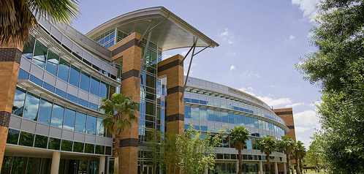
Group 3: DeepGate
Lindsay Davis, EE
Estella Gong, CpE
Michael Lopez, EE
Cedric Orban, EE

Slide 2
Roles & Responsibilities
Lindsay Davis (P), Cedric Orban (S)
  PCB Design
  Hardware Interface
Estella Gong (P), Michael Lopez-Brau (S)
  User Interfaces
  Systems Integration
Michael Lopez-Brau (P), Estella Gong (S)
  Pre-Processing Algorithms
  Deep Learning Algorithms
Cedric Orban (P), Lindsay Davis (S)
  FPGA Firmware Programming
  Hardware Integration & Communication

Slide 3
FPGA Implementation of NN for Speech Recognition
Motivation
Utilizing innovative, unconventional hardware for speech recognition
Active research area
Utilizes our skills
Pursue technical interests

Slide 4
Similar Projects
Microsoft Catapult
  “Moonshot project”
  Using hardware not affected by decreasing improvement as predicted by Moore’s Law
  Huge Success – Enhanced Bing and Azure Products
Google Tensor Processing Unit
  Custom ASICs for machine learning
Notes:
Understanding th efuture applicaions of the unit) Rather than ASICs we’re using a budget friendly

Slide 5
Goals and Objectives
“I think a lot of people don’t know what FPGAs are capable of.”
– Derek Chiou, Head of Microsoft Azure Cloud Silicon Team
Process speech audio data fast enough for real-time recognition
Implement deep neural network algorithm on a low cost FPGA (<$100)
Implement Serial communication Protocol with a high data transfer Rate
Implement GUI to allow for testing Integer and Cardinal Direction speech recognition
Minimize power consumption on PCB (<10 W)

Slide 6
Approach
Research
Development
Testing
Audio
Raspberry Pi
Prototypes
PCB Design
Neural Networks
PCB
GUI
Hardware
Software
E
Notes:
Ouur workflow 3 step process
Not nknowing drones big pic, tech nical details, detail solution

Slide 7
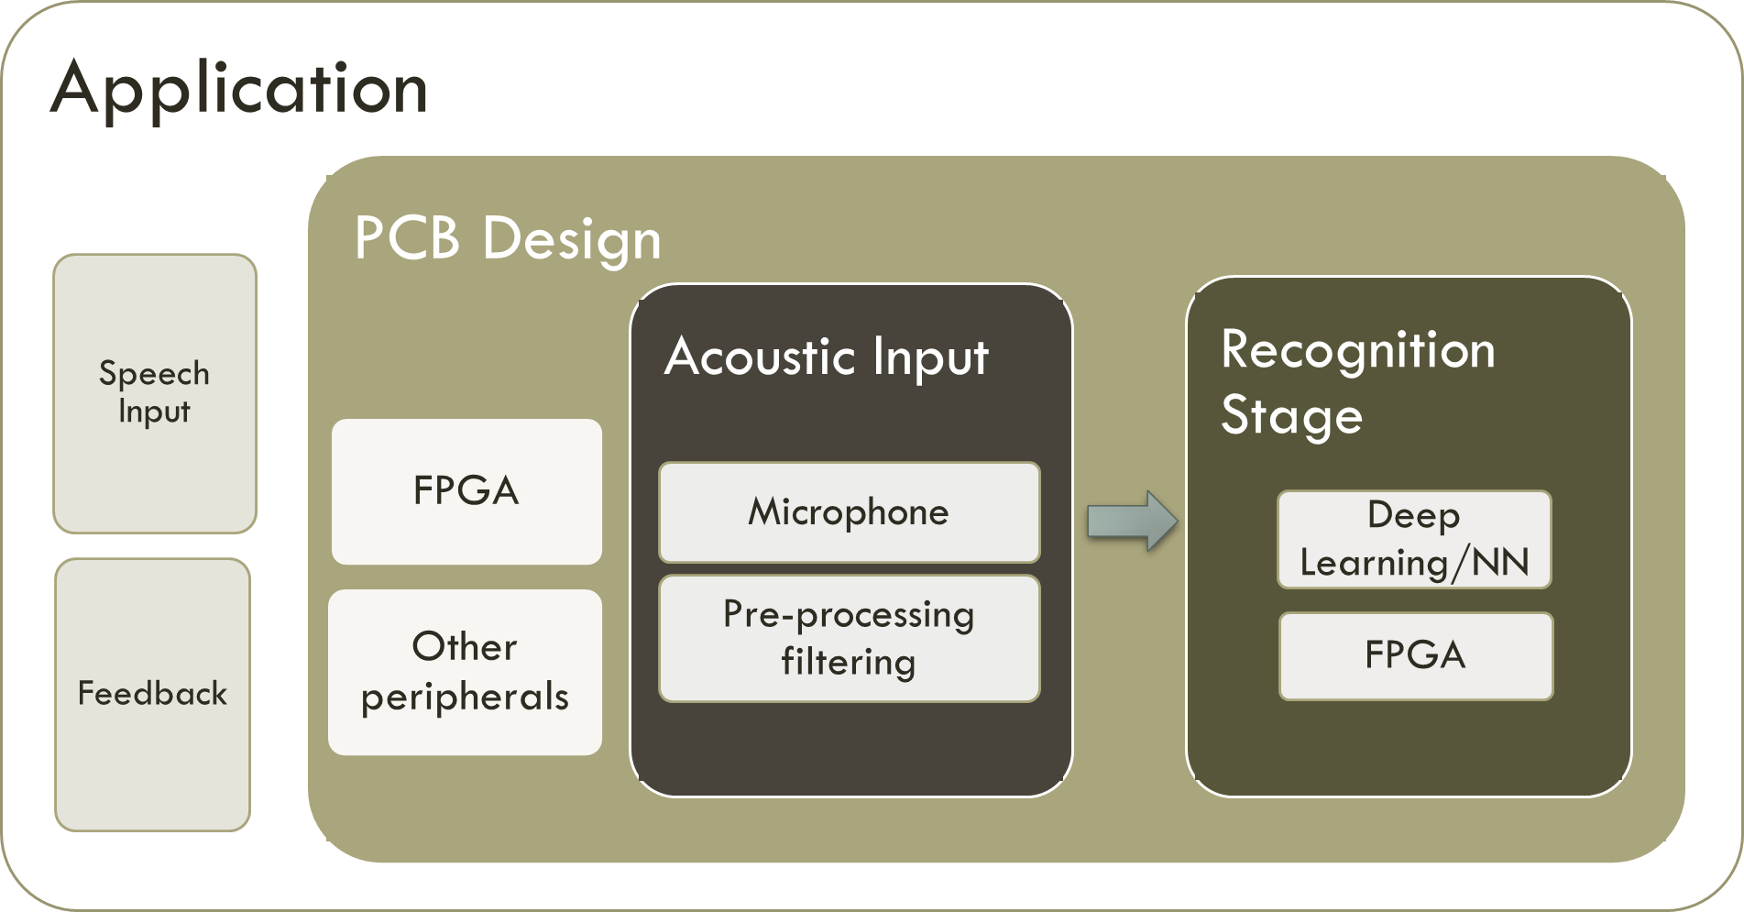
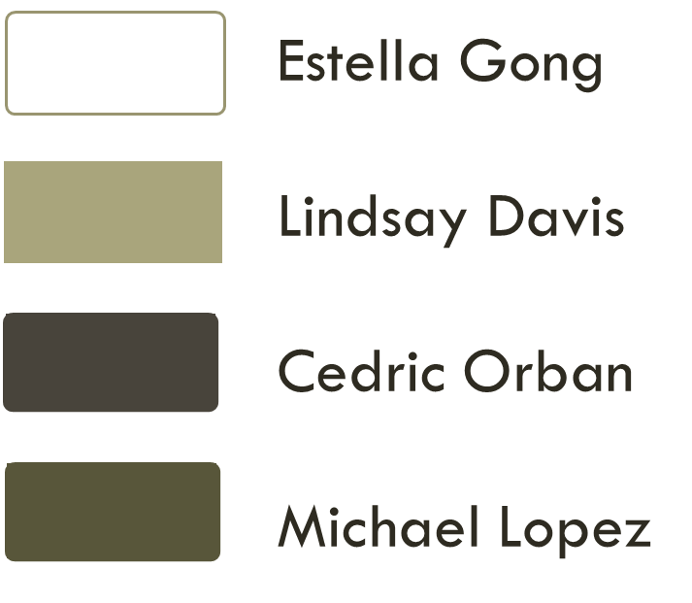
System Task Breakdown

Slide 8
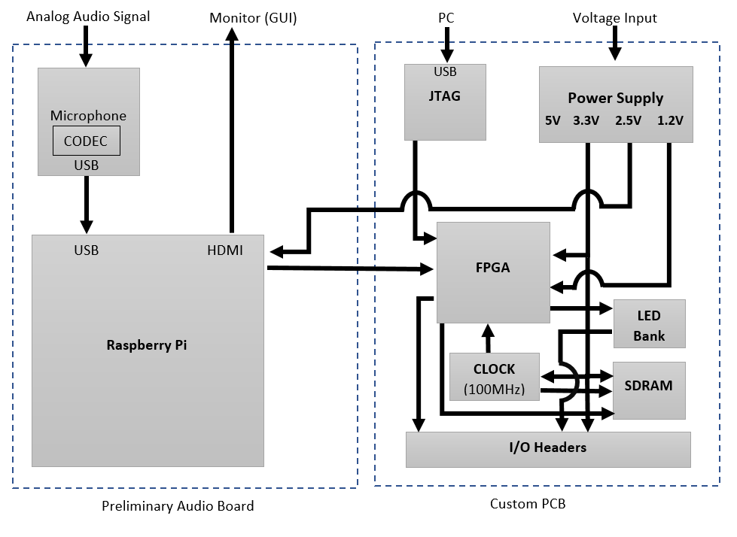
System Block Diagram
Notes:
Now Imagine what if this was simple, what if we could automate this process
(the faster we can get images to gnd control the faster we can begin nprocessing
More efficient were simple. How would that look like

Slide 9
Classification System
Dynamic Time Warping
Hidden Markov Models
Feedforward (Deep) Neural Networks
Convolutional Neural Networks

Slide 10
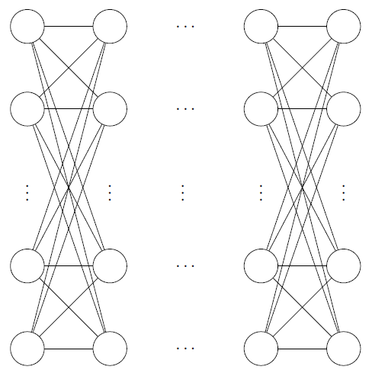
Network Architecture – Overview
Input layer
Hidden layer(s)
Output layer
Data in
Data out

Slide 11
Network Architecture – Parameters
Input layer: 20,000 nodes representing speech sample
Number of hidden layers: ???
Size of hidden layers: ???
Output layer: 14 nodes representing our each word in our vocabulary

Slide 12
Network Architecture – Limitations
Nodes will be represented by an 8-bit number
Weights will store a 3-bit number
Activation function will be approximated via a combinational approximation
Number and size of hidden layers limited by FPGA plus SDRAM storage

Slide 13
Information Pipeline
Await Speech
Digital Signal Processing
Ground Truth
Classifier
Mode
Generate Examples
Train Network
Obtain Result

Slide 14
Why Use an FPGA?
Low-power
Reconfigurable
Can be tuned to a specific application
Relatively Unexplored

Slide 15
Why use a Xilinx Spartan-6?
Free-to-use development environment
Same chip found in our development board
Quad-flat package (QFP)
Low cost

Slide 16
Firmware Constraints & Characteristics
Flexibility
Memory Size
FPGA Size

Slide 17
Architecture Overview – Processing Unit

Slide 18
Architecture Overview – Tile Layout

Slide 19
Architecture Overview – Overall

Slide 20
Firmware Difficulties
High logic resource utilization
Low-end FPGA
Debugging is complex

Slide 21
Performance Targets
Real-Time Speech Recognition
High SPI Bus Data Rate (20 MB/s)
Comparable GFLOPS/Watt/$

Slide 22
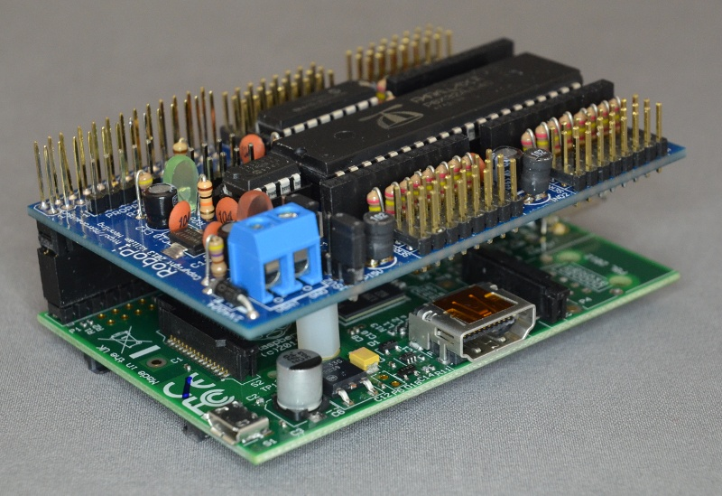
PCB Design
Through-hole v.s. Surface mount
Daughter board to the Raspberry Pi
Modular system

Slide 23
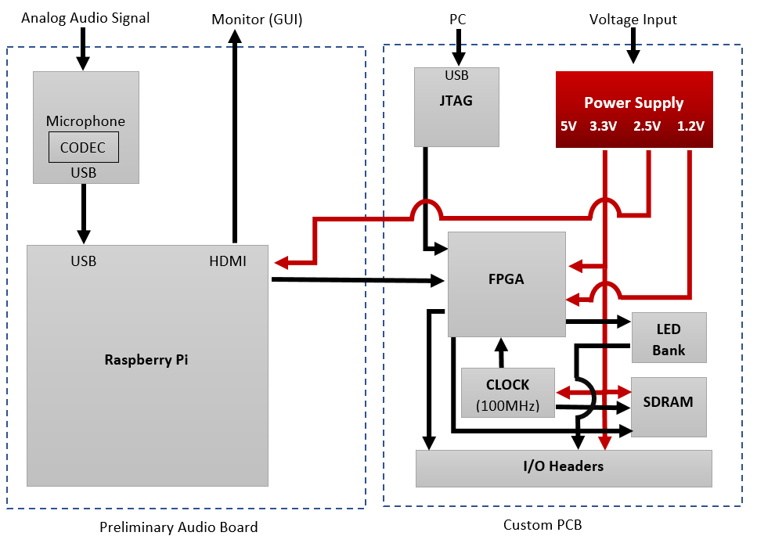
Power - Overview

Slide 24
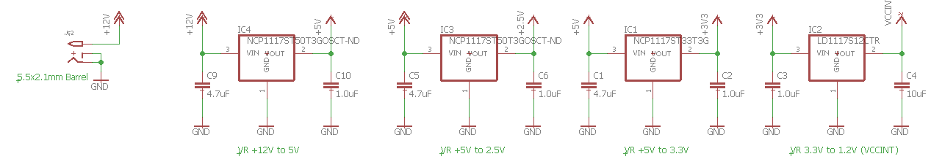
Power – Voltage Regulators
Decoupling capacitors
Four voltage regulators
  5V
  3.3V
  2.5V
  1.2V

Slide 25
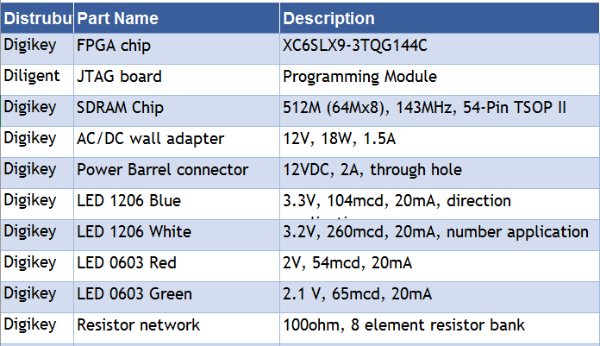
Component Table

Slide 26
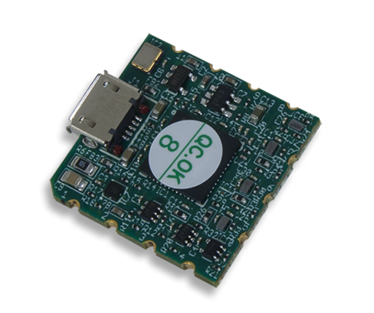
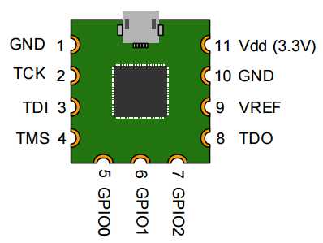
JTAG
Needed to program the FPGA
No programming the module unlike a microcontroller
Surface mount and small
Predesigned FPGA programming module
Micro usb input from PC
Microcontroller needs clock

Slide 27
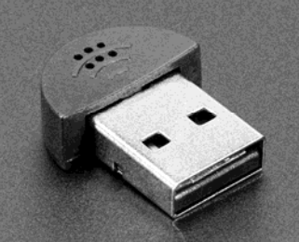
Microphone
USB microphone
Connected to one of the Raspberry Pi USB ports
Receives analog audio signals and converts to digital audio file
The digital file is transferred through USB port to the Raspberry Pi

Slide 28
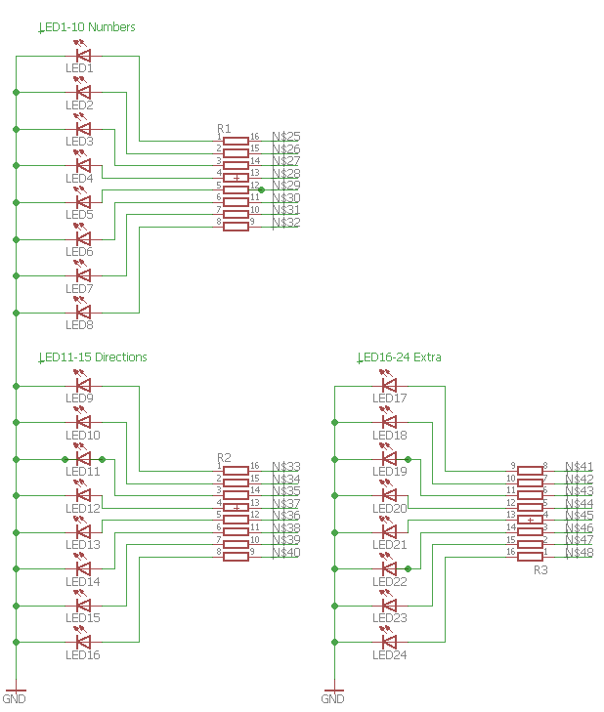
LED Bank
Application LED
  Blue/ White
  1206 pad size
  Brighter
Board LED
  Reset switch LED
  On LED
  Programming LED
  Smaller
  Green/ Red
Resistor bank

Slide 29
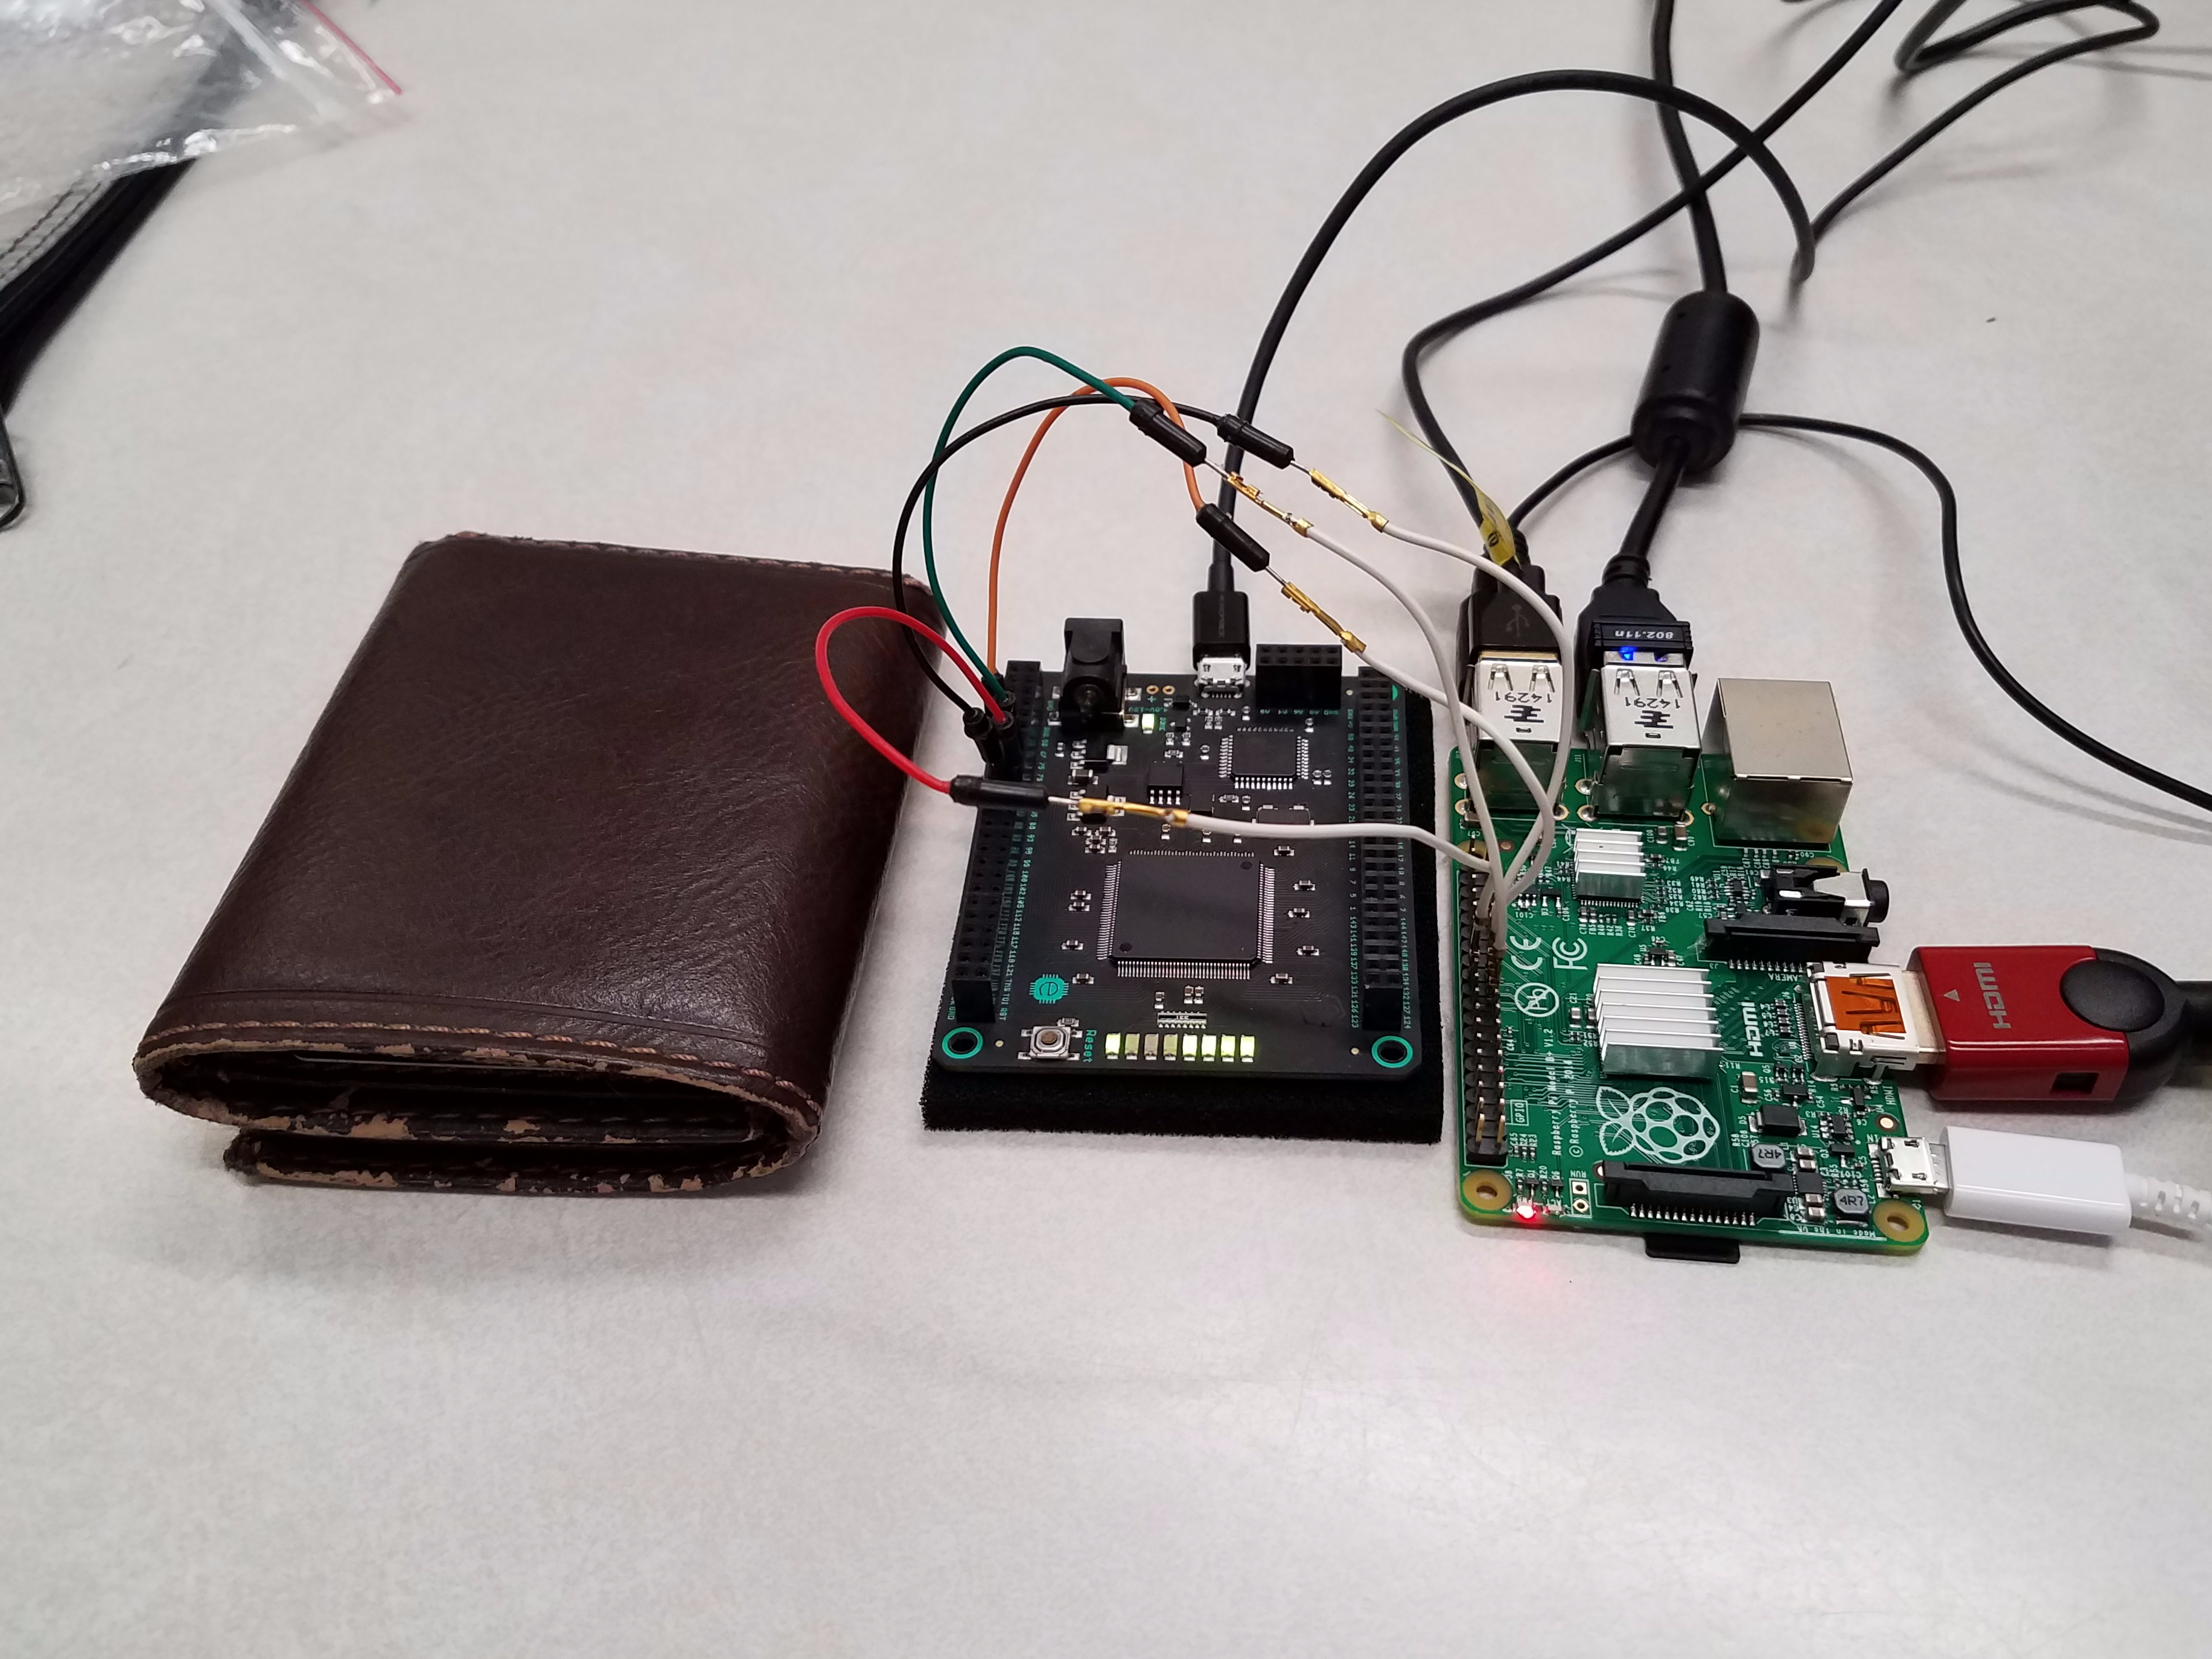
Raspberry Pi
PC → Raspberry Pi
Advantages:
  Smaller, more compact
  Faster data transfer
  Switching from DB9 to using the SPI Bus
  A lot of included features
Notes:
We will be using a Raspberry pI, this will run a GUI application
Communications, I2c and choice
For the data we need.
DB9 on the PC transfers 1 bit at a time
Raspberry pi -> GUI

Slide 30

Operating System: Raspbian Jessie
  Standard OS for Raspberry Pi
  Highly Documented
  Linux Based
  Ability to enable SPI Communication
Notes:
Based off of Debian jessie

Slide 31
Serial Communication - SPI
SPI
RS232
Synchronous interface
Supports chain of multiple devices
Fast data rates (20MHZ) and more on FPGA
Asynchronous Interface
Standard serial communication on Windows
Typically done between 2 devices
Ranges from 100 to 20k baud, typically slower
Notes:
Data transmitted with timing
Asyn, timig is relative to the start it

Slide 32
UI FrameWork – Qt Creator
Microsoft Visual Studio
Qt Creator
Community edition is Open Source
Supports C++, MFC (Windows only)
No standard built- in GUI library
Supports C++ and Python
Recommended for designing GUI’s for the Raspberry Pi
Cross Platform
Wide selection of libraries

Slide 33
GUI Test UI
Home/Default
Record
Train
Speech Recognition
Test
Integer Recognition Mode
Cardinal Direction Mode

Slide 34
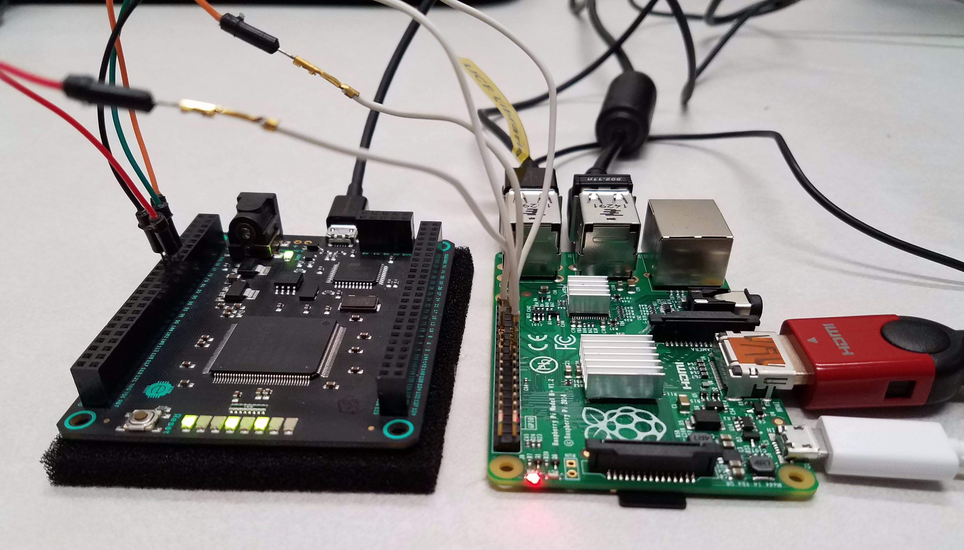
Current Status - Testing

Slide 35
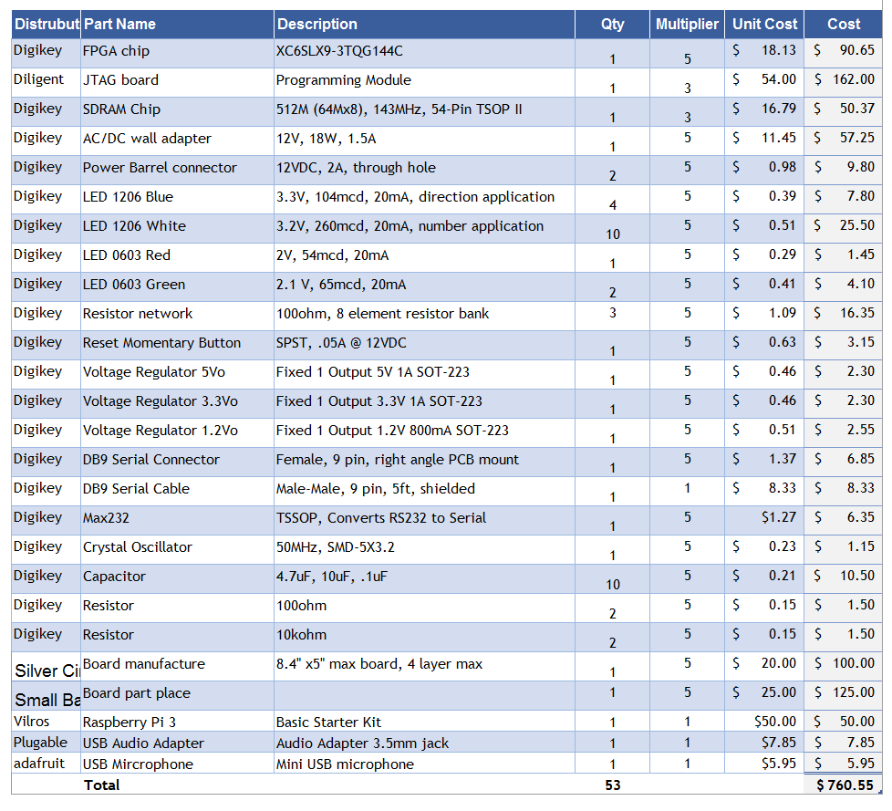
Financing
Sponsor | Amount
SoarTech | $1000

Slide 36
Notes:
90%
50%
35%
20%
Total

Slide 37
Questions?
Group 3

